Slide 1

UBER SUPPLY – DEMAND GAP
-BY SAADIYA

Slide 2
BUSSINESS OBJECTIVE
IDENTIFY THE ROOT CAUSE OF THE PROBLEM ( i.e., CANCELLATION AND NON-AVAILABILITY OF CARS ) AND RECOMMEND WAYS TO IMPROVE THE SITUATION.

Slide 3
DATA USED FOR ANALYSIS
FOR THIS ANALYSIS, ONLY THE TRIPS TO AND FROM THE AIRPORT ARE BEING CONSIDERED.
SPAN OF DATA IS 5 DAYS.

Slide 4
DATASET DETAILS
REQUEST ID : A UNIQUE IDENTIFIER OF THE REQUEST
TIME OF REQUEST : THE DATE AND TIME AT WHICH THE CUSTOMER MADE THE TRIP REQUEST
DROP-OFF TIME : THE DROP-OFF DATE AND TIME, IN CASE THE TRIP WAS COMPLETED
PICK-UP POINT : THE POINT FROM WHICH THE REQUEST WAS MADE
DRIVER ID : THE UNIQUE IDENTIFICATION NUMBER OF THE DRIVER
STATUS OF THE REQUEST : THE FINJAL STATUS OF THE TRIP, CAN BE EITHER COMPLETED, CANCELLED BY THE DRIVER OR NO CAR ARE AVAILABLE

Slide 5
LIBRARIES USED
PANDAS
NUMPY
MATPLOTLIB
SEABORN
DATETIME

Slide 6
DATA CLEANING
IDENTIFYING THE DATA QUALITY ISSUES
FORMAT DATE AND TIME VARIABLES OF THE DATA
FEATURE ENGINEERING DATA FOR ANALYSIS

Slide 7
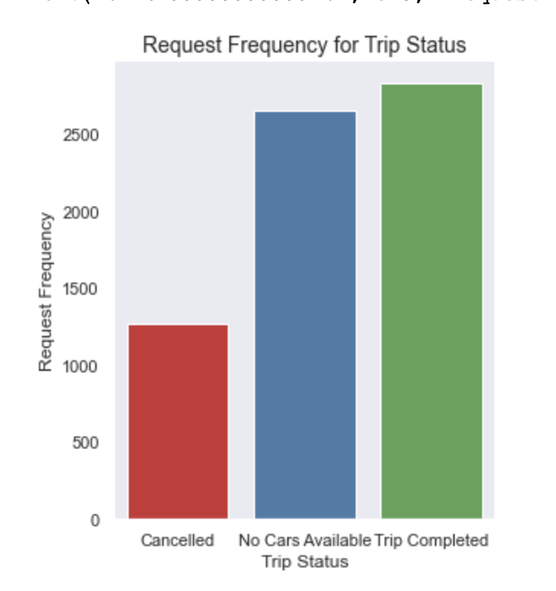
DATA ANALYSIS
FORM THE GRAPH, MOST OF THE FAILED REQUESTS ARE DUE TO NO CARS AVAILABLE.
IT IS EVIDENT THAT UBER IS LOSING A LOT OF BUSSINESS DUE TO NO CARS AVAILABLE TRIP STATUS.

Slide 8
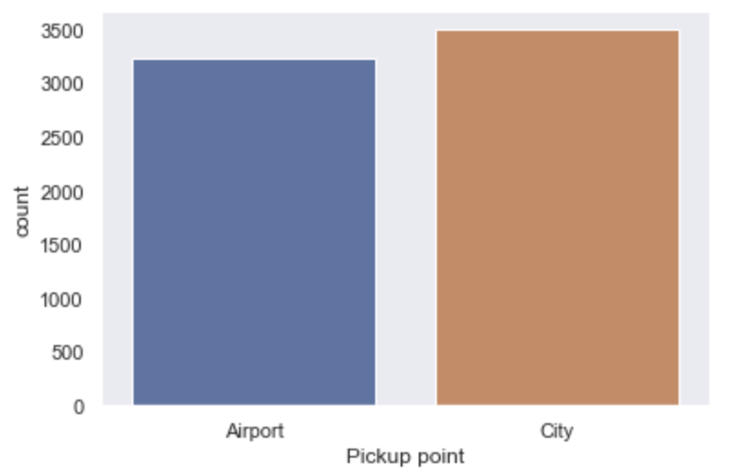
DATA ANALYSIS
FORM THE GRAPH, MOST OF THE PICKUP POINTS ARE FROM CITY
IT IS EVIDENT THAT UBER HAS SLIGHTLY MORE REQUESTS FOR CITY TO AIRPORT TRAVEL

Slide 9
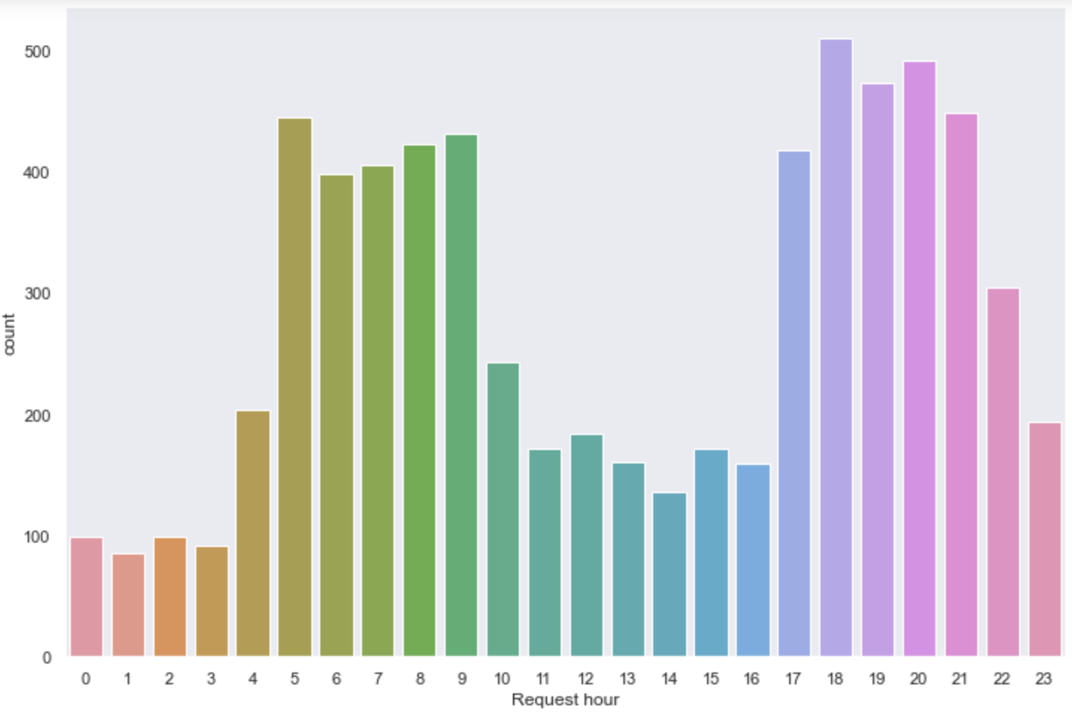
DATA ANALYSIS
FORM THE GRAPH, MOST OF THE REQUESTS ARE MADE IN MORNING AND EVENING FROM 5 AM – 10 AM AND 5 PM – 10 PM.

Slide 10
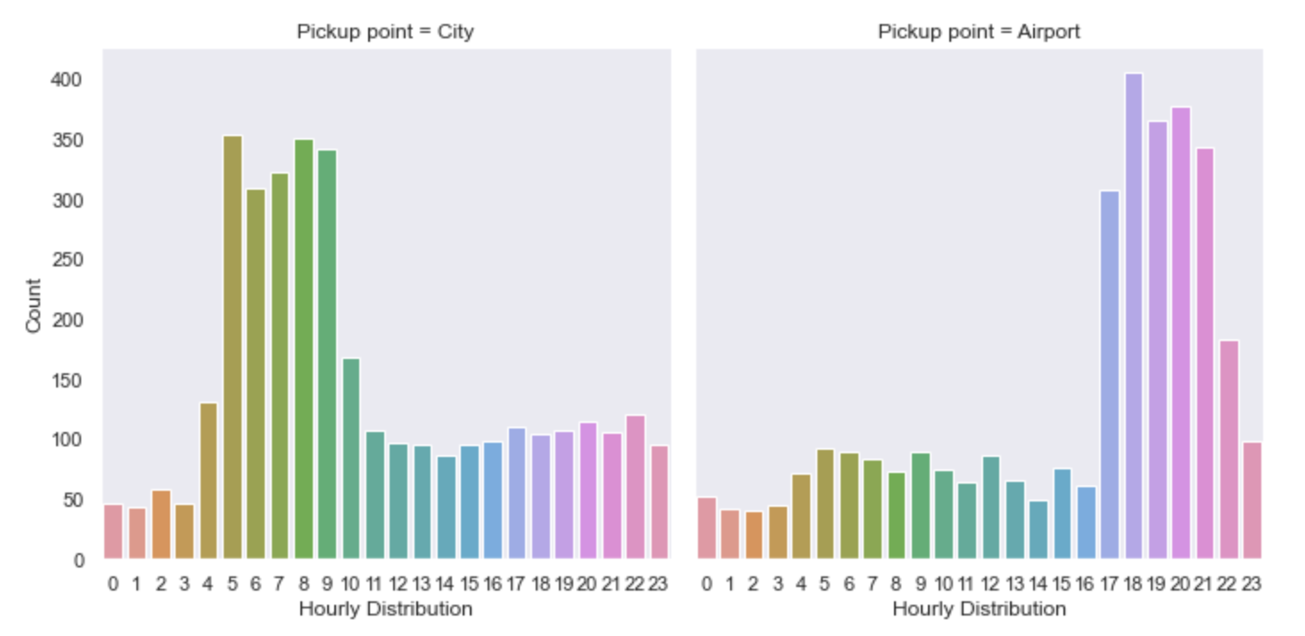
pickup locations segmented by time slots

Slide 11
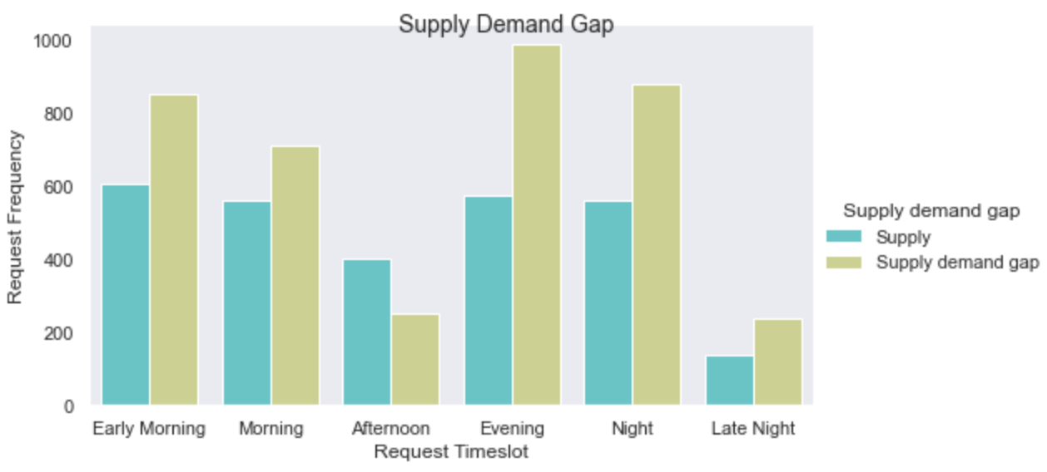
DATA ANALYSIS
FORM THE GRAPH, SUPPLY DEMAND GAP IS MORE THAN THE SUPPLY FOR MOST OF THE TIME DURING THE DAY.

Slide 12
CONCLUSIONS
THERE IS A HUGE GAP IN SUPPLY AND DEMAND
LOT OF RIDES GO INCOMPLETE (UNAVAILABLE OR CANCELLED) IN COMPARISION TO BEING COMPLETED.

Slide 13
CONCLUSIONS
AS PER THE ANALYSIS, ONE OF THE MAIN PROBLEM IS NON AVAILIBILITY OR CANCELLATION OF CABS FROM CITY TO AIRPORT.
IT CAN BE INFERED THAT CAB DRIVERS CANCEL MAXIMUM RIDES DURING EARLY MORNING AND CARS ARE UNAVAILABLE AT NIGHTTIME.

Slide 14
SOLUTIONS
PROVIDE INCENTIVES TO DRIVERS TO PICKUP PASSENGERS FROM CITY DURING EARLY MORNINGS.
PROVIDING NIGHT SHIFTS FOR UBER DRIVERS TO INCREASE THE NUMBER OF DRIVERS AT NIGHTTIME TO TACKLE THE PROBLEM OF INCOMPLETE TRIP DUE TO NO CARS AVAILABLE.

Slide 15
SOLUTIONS
INCREASING THE NUMBER OF CARS TO REDUCE THE SUPPLY DEMAND GAP
NUMBER OF CANCELLING THE REQUEST BY THE CAB DRIVER CAN BE LIMITED AND PENALTIES CAN BE IMPOSED FOR EXCEEDING THE LIMIT.
PROMOTE EARLY BOOKINGS TO AIRPORT.

Slide 16
THANK YOU

